Slide 1


Build 2020
HIGHLIGHTS
On Demand - https://mybuild.microsoft.com/

Slide 2



VIKAS GOYAL
Bangalore, India
Role
Solution Architect – App Innovation & Artificial Intelligence
Part of Microsoft Account Team
Please reach out for
Envisioning new experiences
Deep dive Azure architecture workshops
Technology Roadmaps
Azure Skilling and Certification
vikasgoyal
vikas.goyal

Slide 3
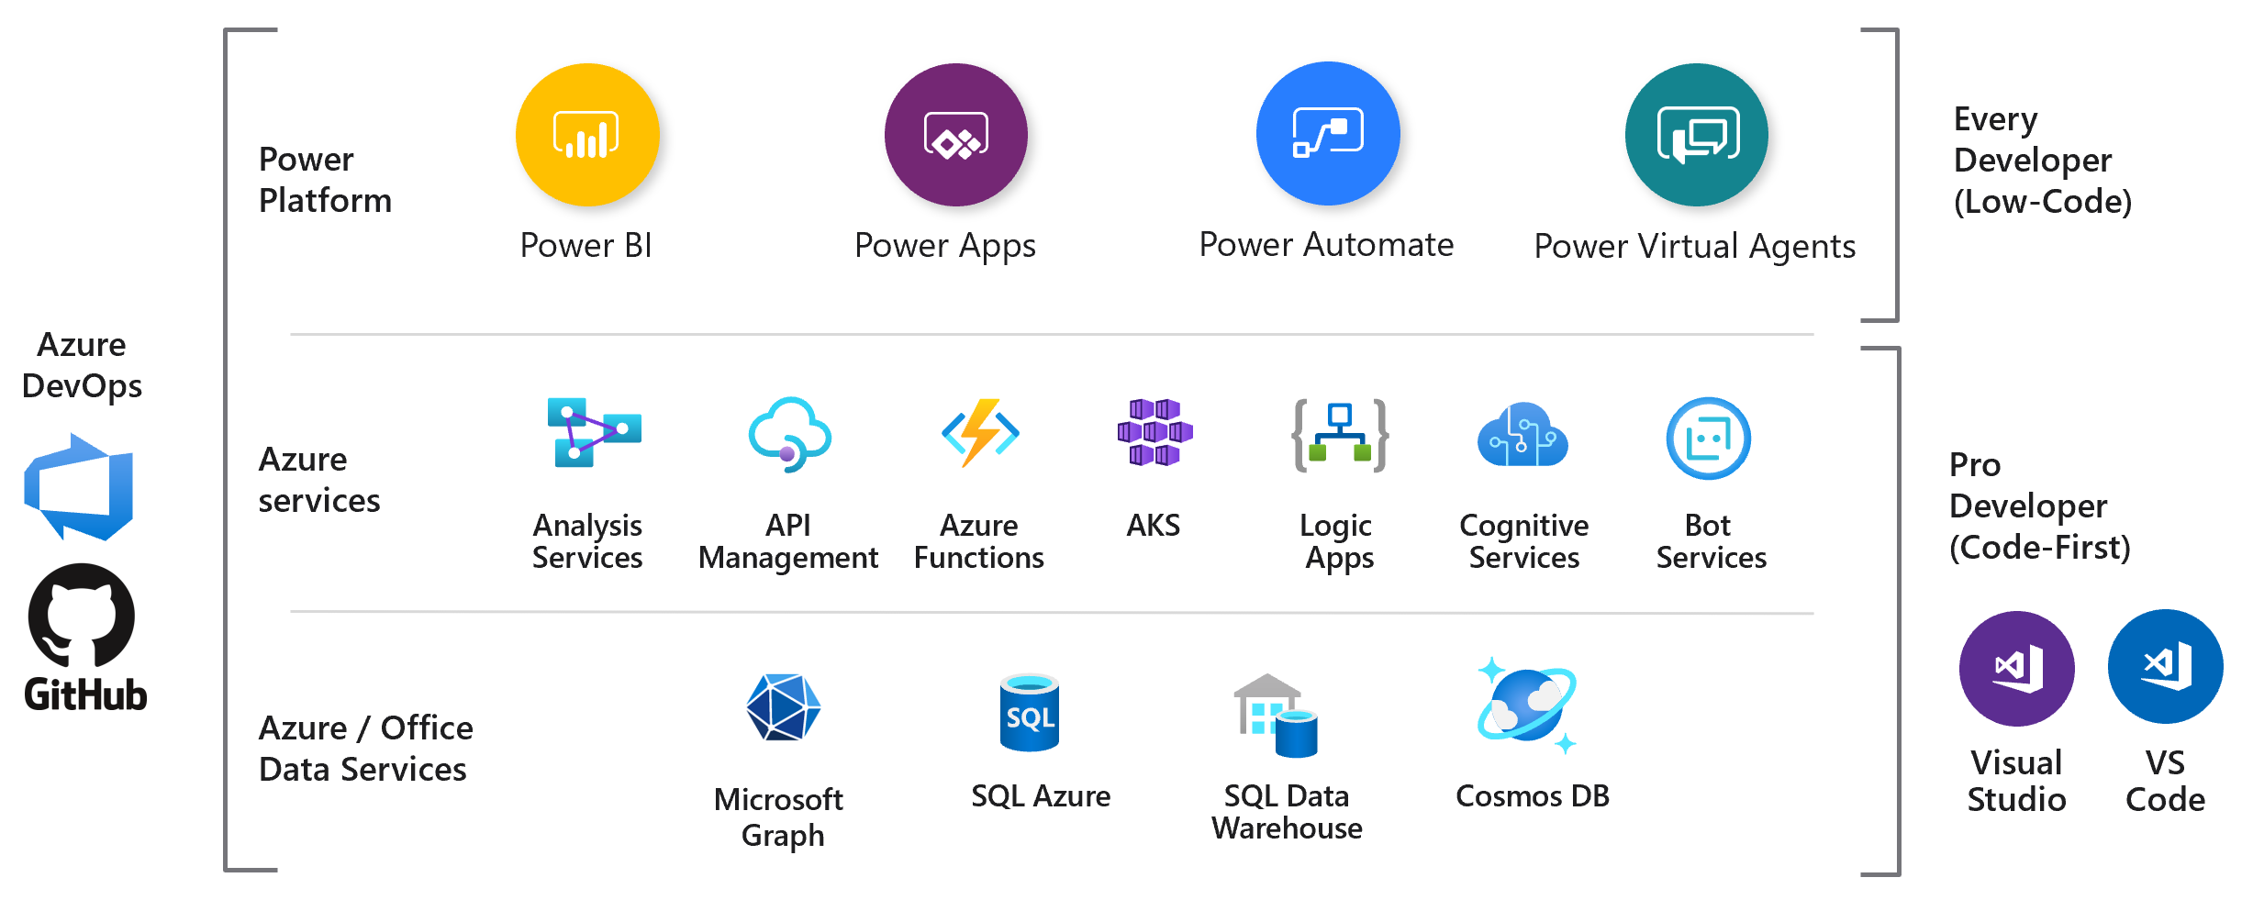
The Developer Continuum

Slide 4
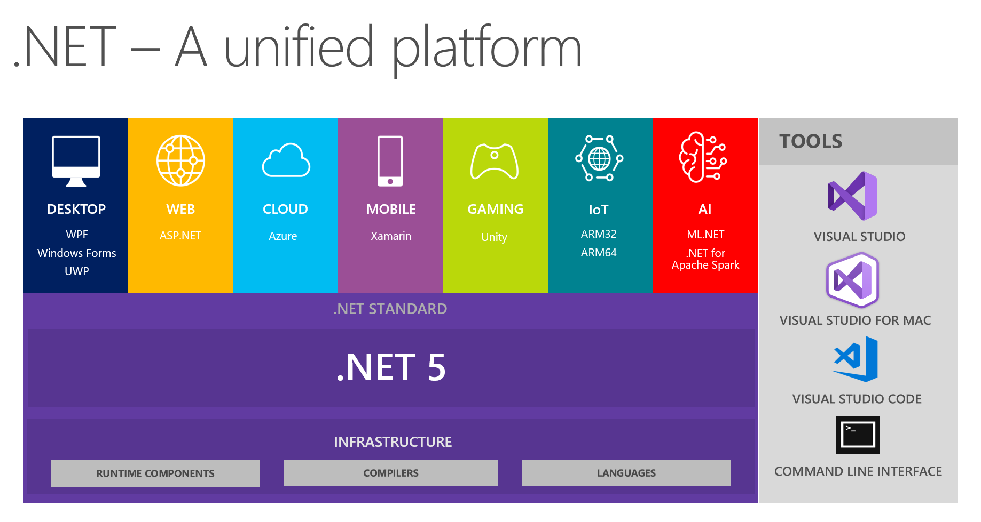
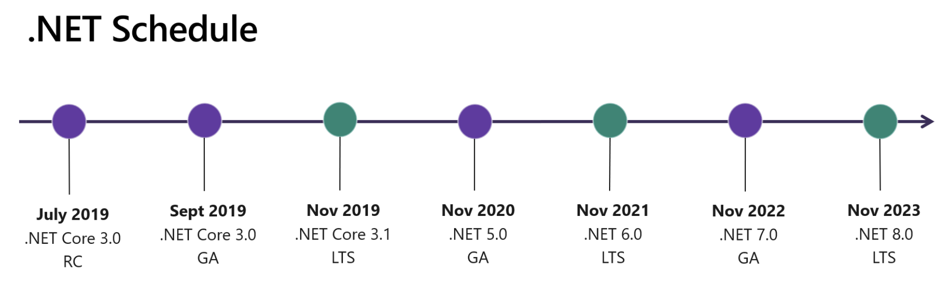
.NET 5 (Preview 4)
C# 9
F# 5
Single file apps
ARM64
Containers
JSON APIs
Notes:
https://devblogs.microsoft.com/dotnet/announcing-net-5-preview-4-and-our-journey-to-one-net/

Slide 5
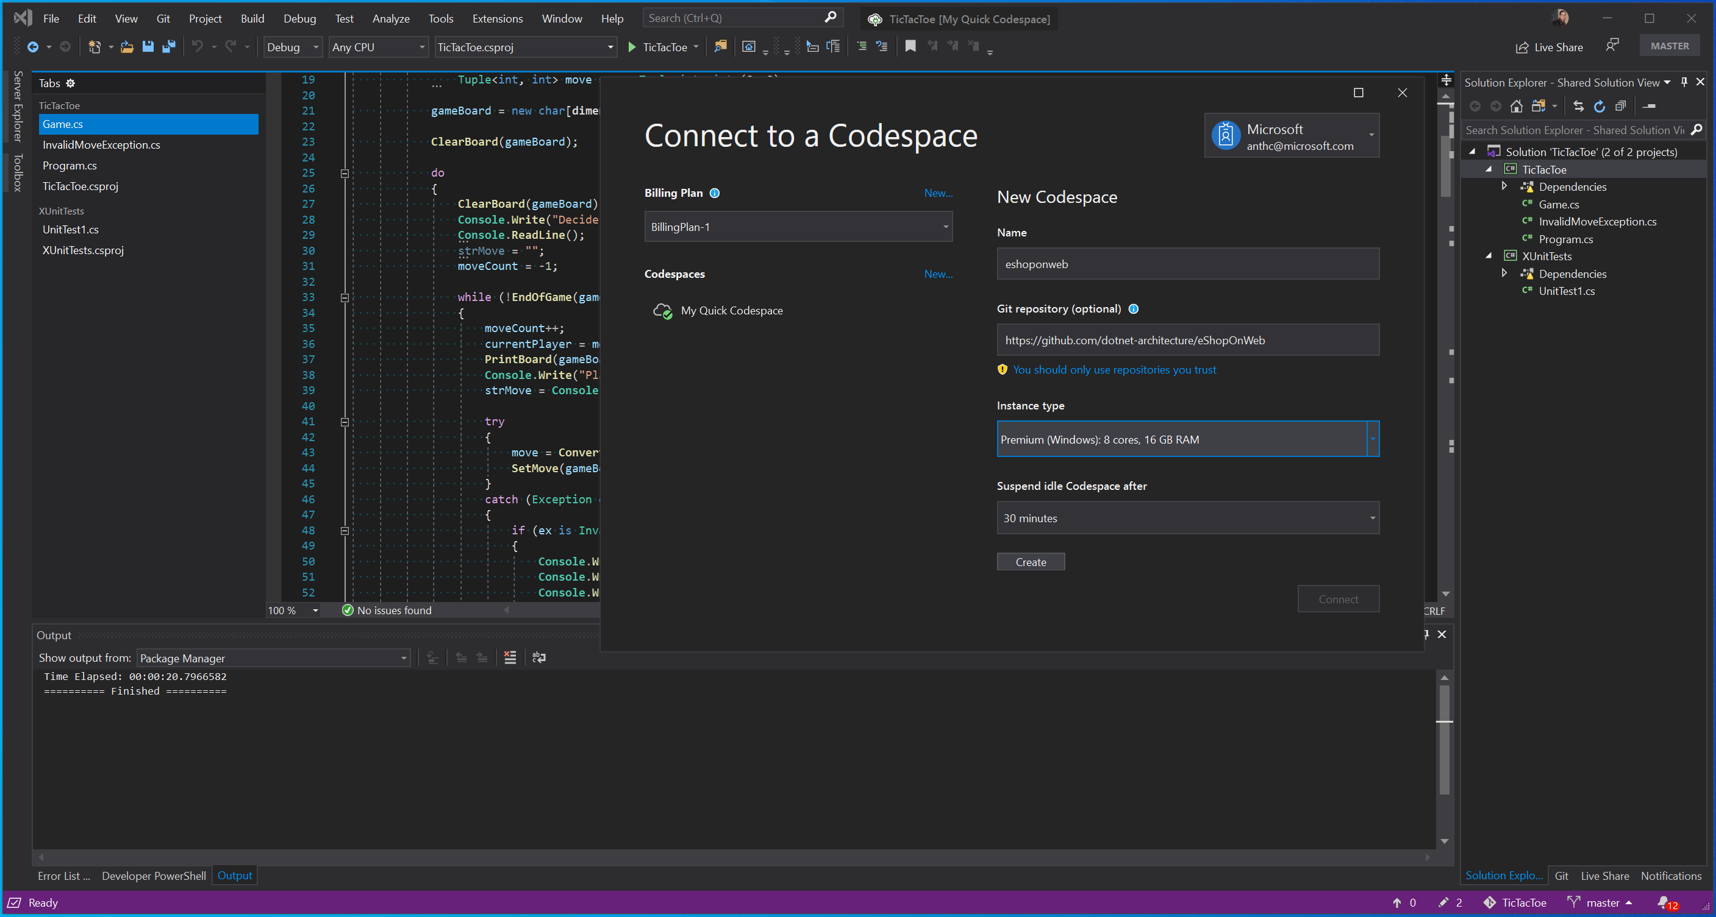
Visual Studio Codespaces
Cloud-hosted dev environments accessible from anywhere
Available in Preview
Access it from Visual Studio Code or Visual Studio or web-based editor
Source code
Runtimes
Linters & debuggers
Extensions
Notes:
https://visualstudio.microsoft.com/services/visual-studio-codespaces/

Slide 6
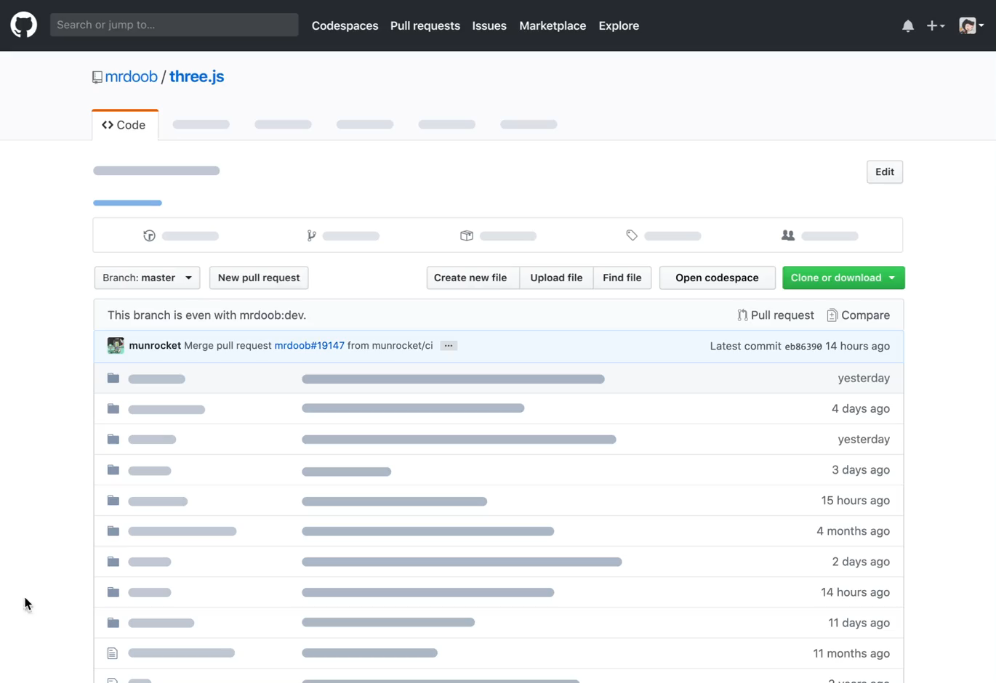
Codespaces coming to GitHub
Notes:
https://github.com/features/codespaces

Slide 7
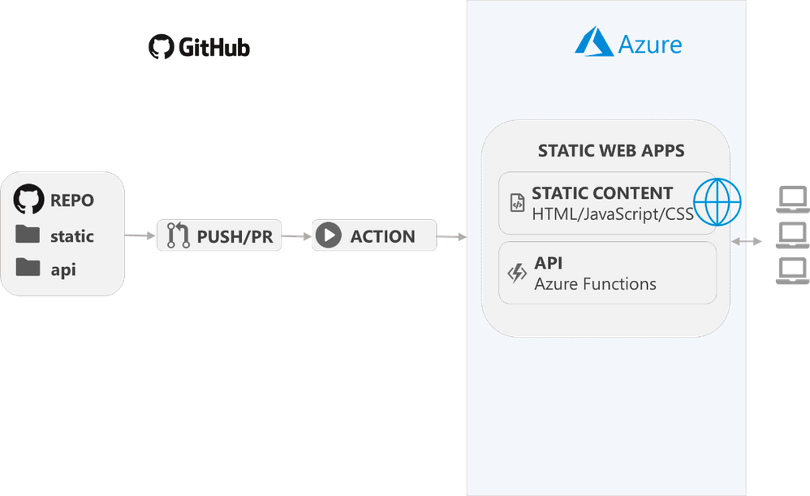
App Service Static Web Apps
Preview (Free)
Integrated API support provided by Azure Functions.
First-party GitHub integration where repository changes trigger builds and deployments.
Globally distributed static content, putting content closer to your users.
Notes:
https://docs.microsoft.com/en-us/azure/static-web-apps/overview

Slide 8
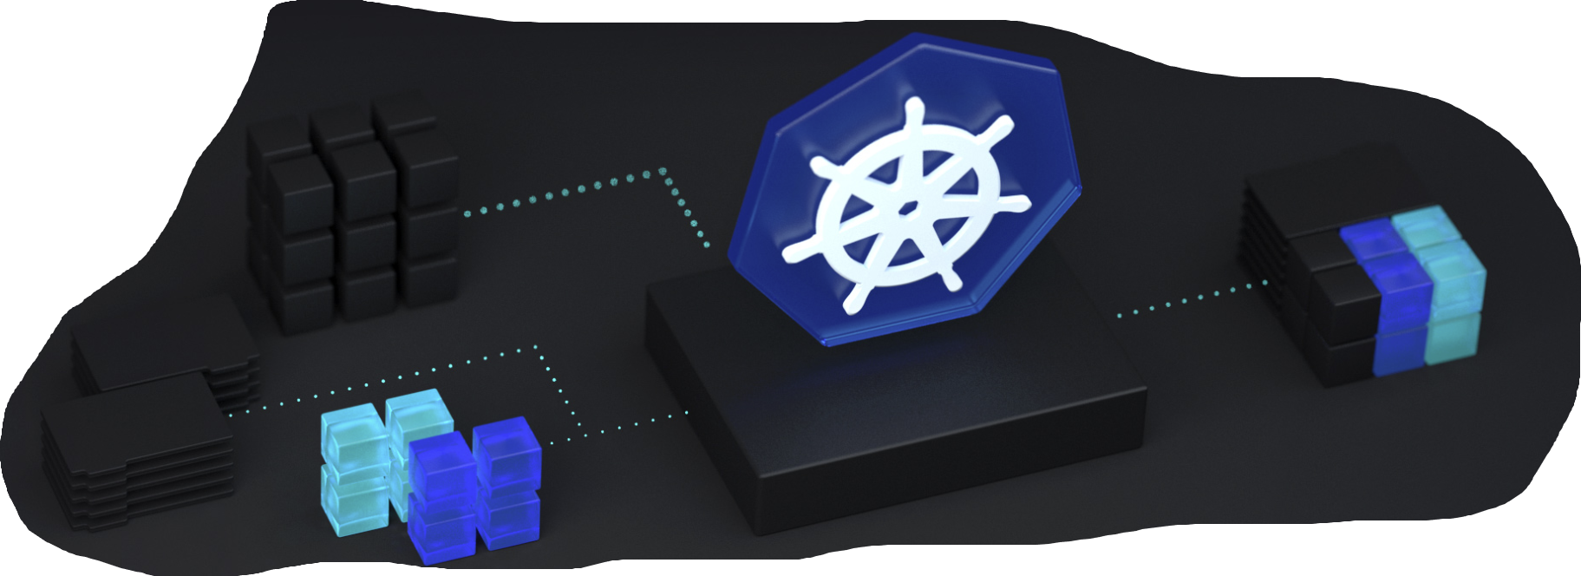
Azure Kubernetes Service Updates
General availability of Windows Server container support
Running both Windows and Linux applications side by side in a single AKS cluster
Private clusters & Managed Identities
Kubernetes in the Cloud Adoption Framework
Review a prescriptive framework that includes the tools, programs, and content (best practices, configuration templates, and architecture guidance) to simplify adoption of Kubernetes and cloud-native practices at scale.
Kubernetes learning and training
Notes:
https://azure.microsoft.com/en-us/blog/announcing-the-general-availability-of-windows-server-containers-and-private-clusters-for-azure-kubernetes-service/

Slide 9

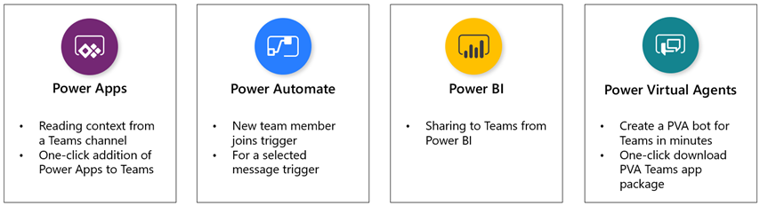
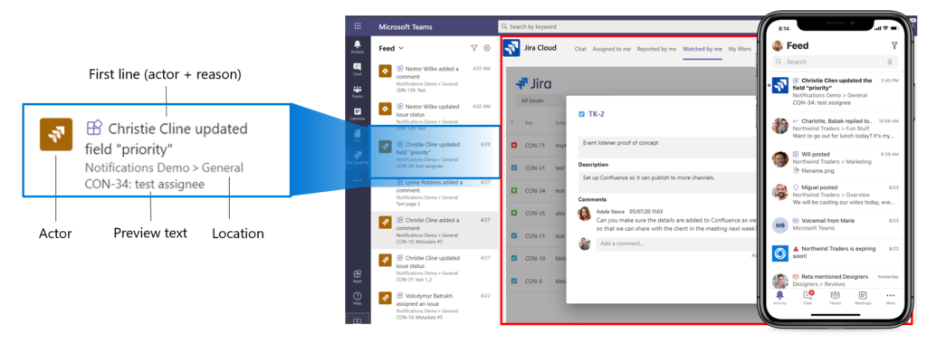

Devs Microsoft Teams
Azure Active Directory Single Sign-On (SSO) to eliminate need for re-signing into Teams apps. We’ll roll out with tabs in general availability soon, followed by bots later this year.
Messaging actions for mobile
Adaptive Cards 1.2 in Teams on desktop and mobile.
New Microsoft Graph APIs in v1.0 - Send channel messages API allows you to send channel messages and replies as well as include attachments.
Activity feed notifications via the Microsoft Graph API
Mobile device capability for apps - connecting to native mobile device features, such as camera, location, and microphone.
Power Platform + Teams enhancements
Visual Studio and Visual Studio Code extension
Notes:
https://developer.microsoft.com/en-us/microsoft-teams/blogs/?p=4590

Slide 10
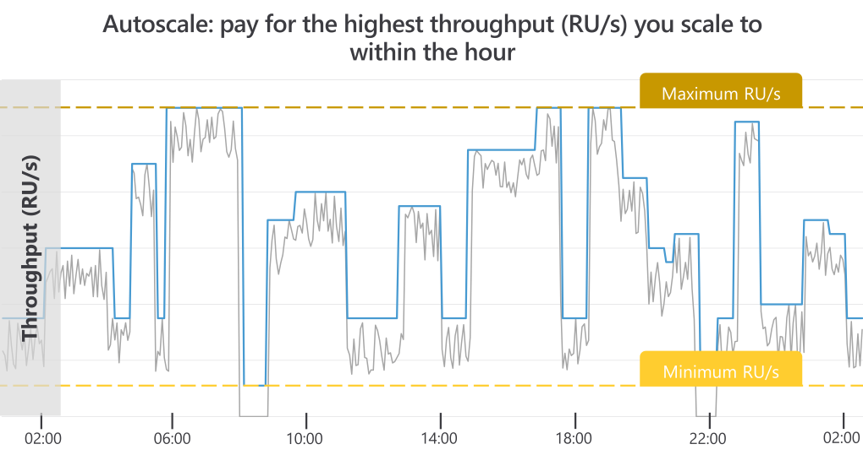
CosmosDB Autoscale + Serverless: fit any workload
Autoscale provisioned throughput (GA)
Variable or unpredictable workloads
Infrequently used applications
Scheduled production workloads/queries
Notes:
https://devblogs.microsoft.com/cosmosdb/autoscale-serverless-offers/

Slide 11
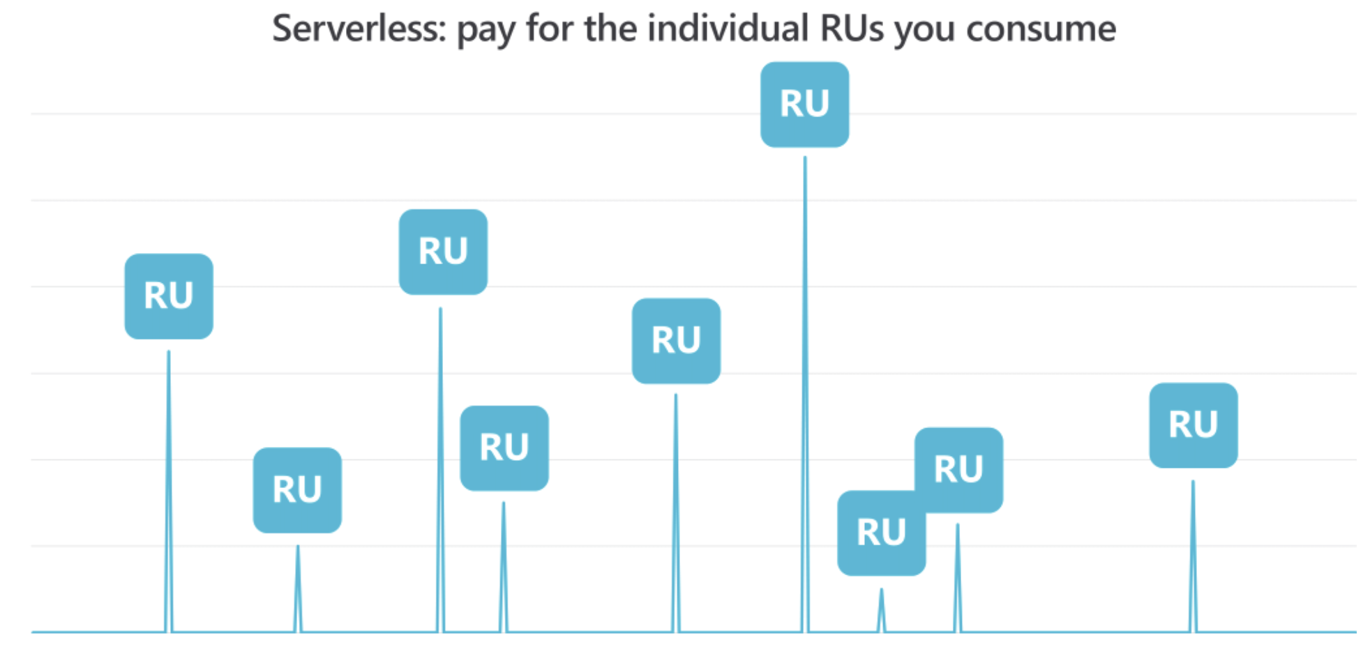
CosmosDB Autoscale + Serverless: fit any workload
Pay for the request units (RU) consumed by your database operations
Public preview in the next couple of months
Available for all Azure Cosmos DB APIs.
Build a prototype, or even run small, non-critical applications
Notes:
https://devblogs.microsoft.com/cosmosdb/autoscale-serverless-offers/

Slide 12
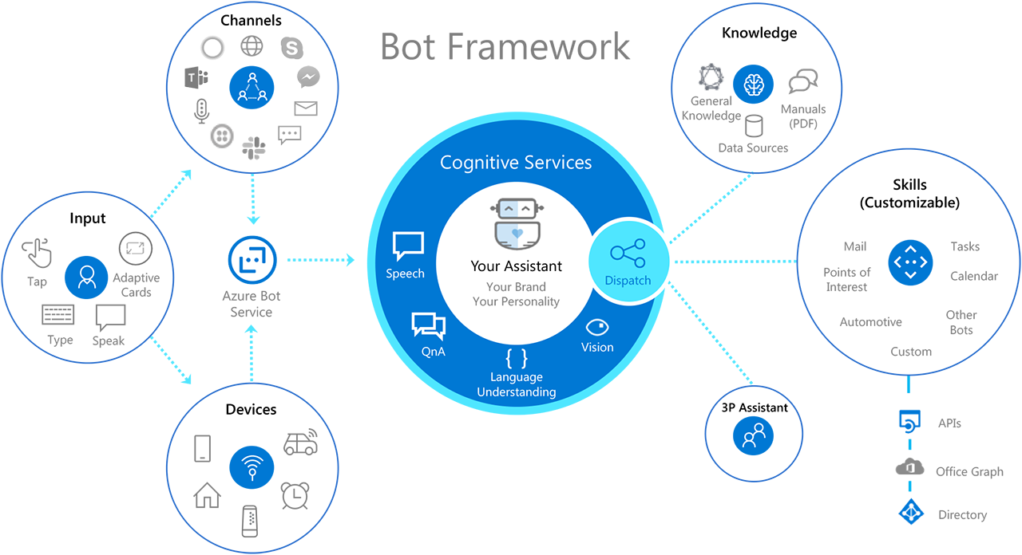
Bot Framework (v4.9.1)
Adaptive Dialogs – GA. A more flexible, event driven dialog system for implementing multi-turn conversational patterns.
Skills - Skills now support adaptive dialogs and all activity types and have improved support for SSO and OAuth. The v2.1 skill manifest is now GA. We also added Bot Framework Composer support for building and consuming Skills.
Bot Composer GA - an integrated development tool that developers and multi-disciplinary teams can use to build bots
Alexa channel available in preview
Notes:
https://docs.microsoft.com/en-us/azure/bot-service/what-is-new?view=azure-bot-service-4.0
https://azure.microsoft.com/en-us/updates/azure-bot-service-and-bot-framework-updates-for-build-2020/

Slide 13
Cognitive Services Updates
Computer Vision—Advanced text extraction
Read 3.0, is now generally available and expanding its language coverage beyond English and Spanish to include French, German, Portuguese, Italian, and Dutch. Read 3.0 in containers is also available in preview.
Containers
Deploy Cognitive Services anywhere from the cloud to the edge with containers. Language Understanding and Text Analytics sentiment analysis in containers are now generally available.
Language Understanding
Revamped the labeling experience, making it easier to build apps that can understand the complex language structures. For example, “I want a large chicken pizza without sauce and a medium pizza with olives,” there are two different language structures within the same order. This new portal makes it easier to break apart complex requests into related parts.
QnA Maker
Use Role-based Access Control (RBAC), to enable users to collaborate on knowledge bases, making it even easier to collaborate on rapid bot development. QnA Maker is now giving more control to content managers with a rich text editor they can use to control the formatting of responses to users.
Notes:
https://azure.microsoft.com/en-us/services/cognitive-services/

Slide 14
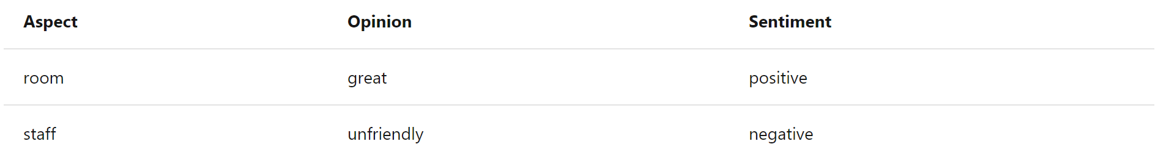
Text Analytics – Opinion Mining
Opinion mining is a feature of Sentiment Analysis, starting in version 3.1-preview.1. Also known as Aspect-based Sentiment Analysis in Natural Language Processing (NLP), this feature provides more granular information about the opinions related to aspects (such as the attributes of products or services) in text.
For example, if a customer leaves feedback about a hotel such as
"the room was great, but the staff was unfriendly"
opinion mining will locate aspects in the text, and their associated opinions and sentiments:
Notes:
https://docs.microsoft.com/en-us/azure/cognitive-services/text-analytics/how-tos/text-analytics-how-to-sentiment-analysis?tabs=version-3

Slide 15
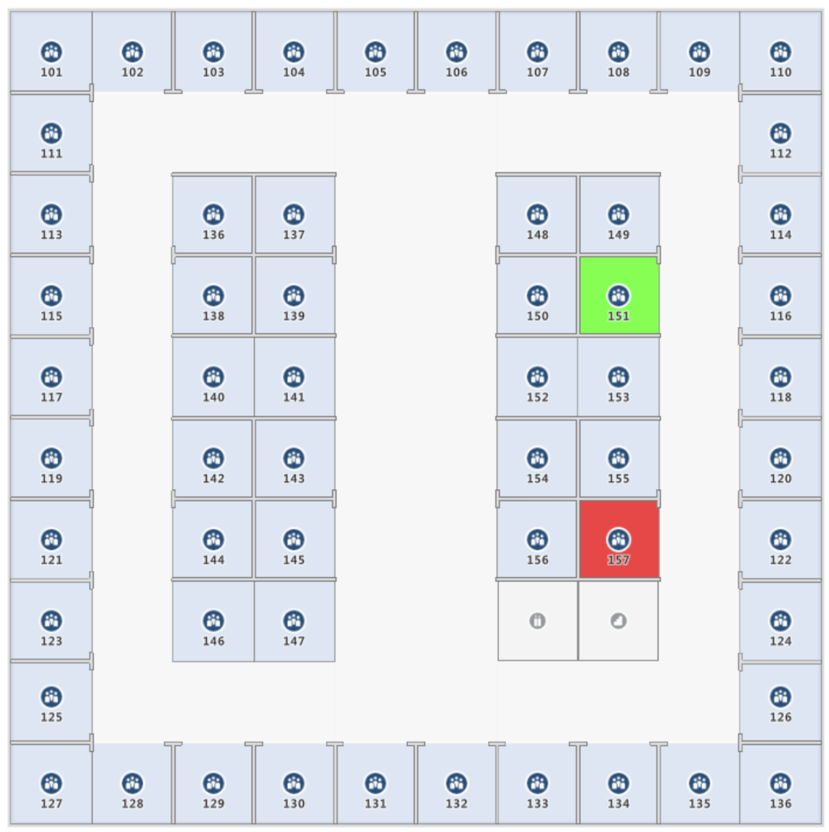
Azure Indoor Maps (Public Preview)
Upload private spaces and asset information to Azure Maps
Spatial intelligence capabilities and map visualization
Upload data from sensors and other sources
Dynamically render indoor map features
Notes:
https://docs.microsoft.com/en-us/azure/azure-maps/creator-indoor-maps

Slide 16
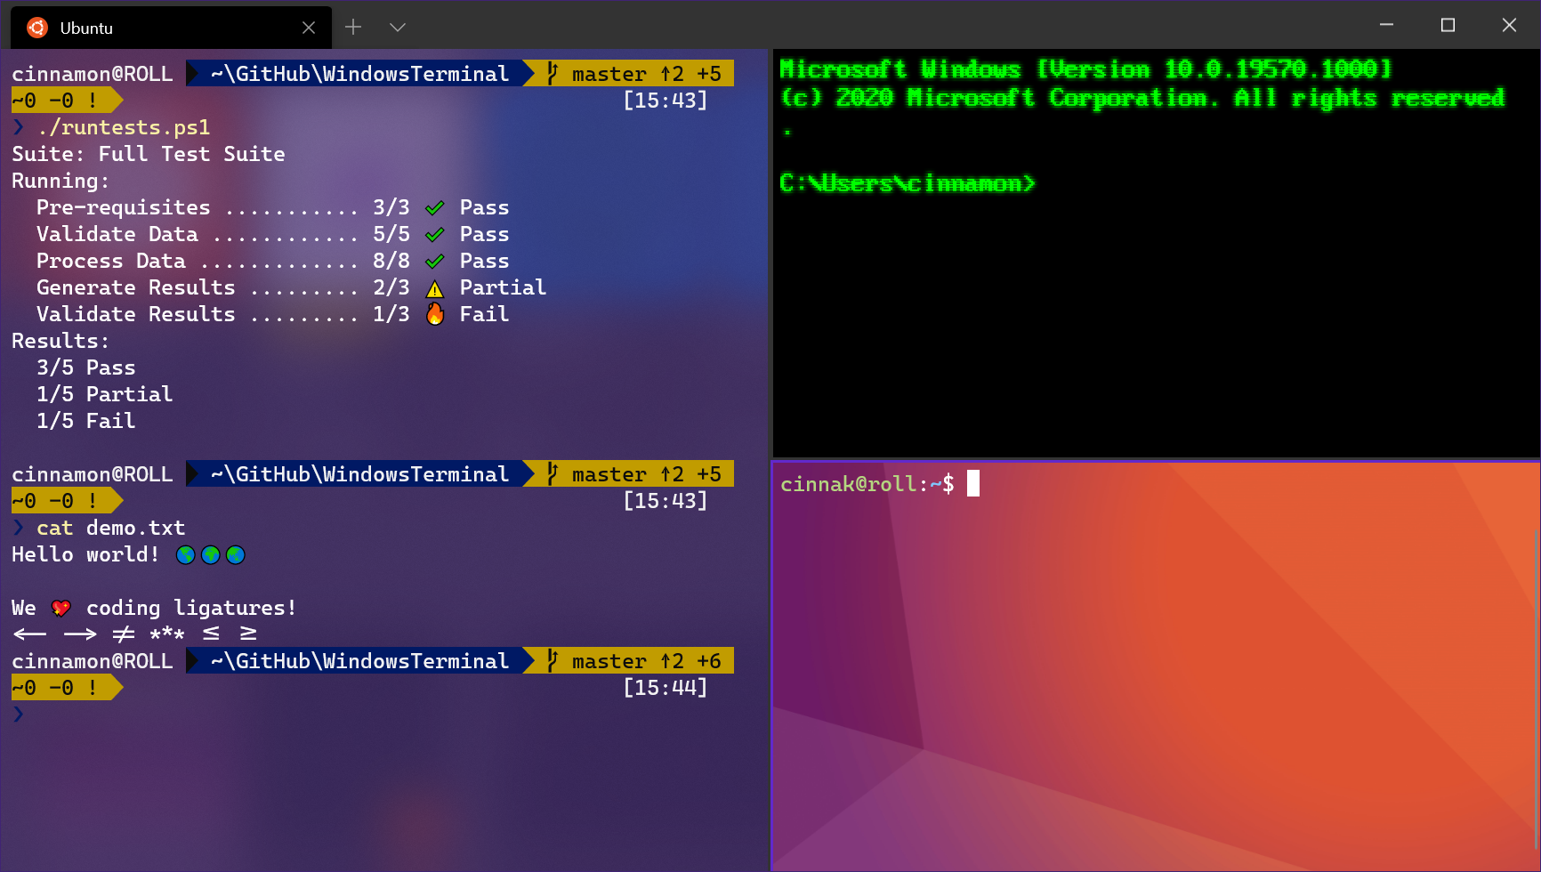
Windows Terminal (GA)
I call it Cloud Engineer’s Desktop.
Any application that has a command line interface e.g. PowerShell and Command Prompt to Azure Cloud Shell and any WSL distribution such as Ubuntu or Oh-My-Zsh.
Customized schemes and configurations
Custom key bindings
Tabs and Panes
Notes:
https://docs.microsoft.com/en-us/windows/terminal/

Slide 17
Microsoft Authentication Library
MSAL Angular is generally available
Microsoft.identity.web for ASP.NET Core is now in public preview.
Public preview of the Integration Assistant in Azure AD app registrations. The Integration Assistant analyzes your app registration and benchmarks it against a set of recommended security best practices.
Publisher Verification (in public preview). Publisher Verification allows developers to demonstrate to customers that the application they’re using comes from a trusted and authentic source.
Azure AD External Identities in public preview. Developers can now build flexible, user-centric experiences that enable self-service sign-up and sign-in with social IDs like Facebook and Google and allow continuous customization without duplicating coding effort.
Notes:
https://techcommunity.microsoft.com/t5/azure-active-directory-identity/build-2020-fostering-a-secure-and-trustworthy-app-ecosystem-for/ba-p/1257360#

Slide 18

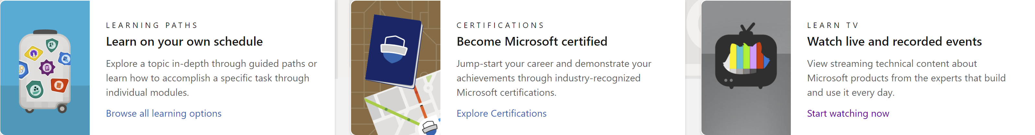
https://docs.microsoft.com/en-us/learn/
Notes:
https://docs.microsoft.com/en-us/learn/

Slide 19

Thank You

